Slide 1


Slide 2


NETAJI SUBHAS INSTITUTE OF TECHNOLOGY
AMHARA , BIHTA PATNA
SINCE: 2008​
A DIGITAL INDIA PROPOSAL
Schools & Colleges.
Still running on WhatsApp.
A unified student management system for schools and colleges
Hans Raj Kumar | B.Tech CSE, 1st Year

Slide 3


No One Knows Where a Student Stands
Not the school. Not the college. And not the people who care most — parents.
Progress goes untracked
Attendance, grades, and pending work sit scattered across registers and group chats — so a student can quietly fall behind for weeks before anyone notices.
Parents are locked out
There's no dashboard, no single update — parents find out about a missed deadline or a slipping grade only when a teacher happens to mention it, often after it's too late to help.
Our proposal closes this gap — building transparency and accountability into the system, for students, parents, and institutions alike.
2

Slide 4


The Scale We're Talking About
India's education system is one of the largest in the world.
14.72 lakh
52,000+
Schools in India
Colleges in India
UDISE+ 2023–24, Ministry of Education
~43.3 million students in higher education
3

Slide 5



Why It's Still Broken
No mandated digital standard
Each institution builds — or skips — digital record-keeping entirely on its own, with no common framework to follow.
Manual, repeated entry
The same piece of information — a deadline, a grade, a notice — gets typed separately into a register, a WhatsApp group, and a notice board.
Infrastructure is still catching up
Even in 2024–25, only about 65% of schools nationally have computer access — up from 57% the year before, but still a real gap.
4

Slide 6
The Real Cost — In One Screenshot
Students
Miss deadlines they never saw coming — no single place shows what's due.
Faculty
Re-enter the same TOPICS on whiteboard multiple times manual systems.
This gap — invisible until it's too late — is exactly what the system below is built to catch.
Students
See I am falling behind only after it's already too late to act.
5

Slide 7

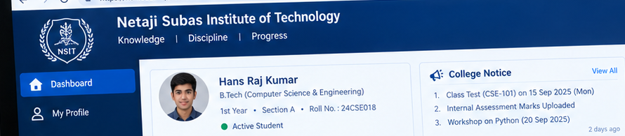
One Login. One System.
A unified student portal — replacing five disconnected systems with a single identity.
Concept mockup — illustrative design for this proposal
6

Slide 8
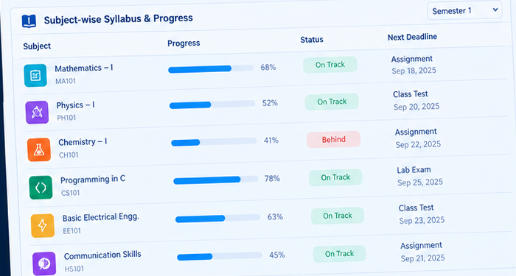
Tracking, Before It Becomes a Problem
Chemistry — 41%, flagged “Behind” automatically, before the Sep 22 deadline arrives.
7

Slide 9
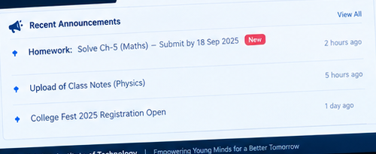
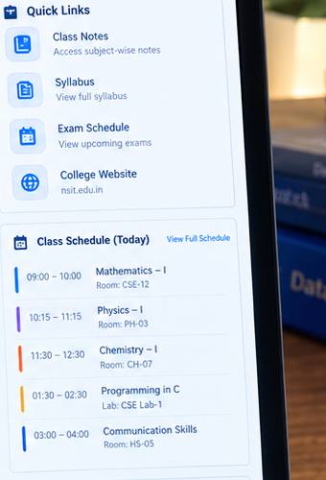
Replacing Five Apps With One
All notices — homework, uploads, events — land in one feed instead of scattered WhatsApp groups.
8

Slide 10

The barrier isn't technology.
It's adoption at the college level
— that's the gap this project closes.
CURRENT STATUS
Accessible design is rare.
Digital training is limited.
Rural connectivity lags.
9

Slide 11
One login. Every student.
One step closer to Digital India.
FUTURE SCOPE
Mobile app version for offline-friendly access
Biometric attendance integration
AI-based early-warning for at-risk students
10

Slide 12

References
UDISE+ 2023–24 Report, Department of School Education & Literacy, Ministry of Education, Government of India LINK
UDISE+ 2024–25 findings, Press Information Bureau, Government of IndiaLINKS
Higher Education in India: Trends & Index, India Brand Equity Foundation (IBEF)LINK
Can Digital India Bridge the Learning Divide in Colleges?, Education for All in India
Thank you
11

